Slide 1
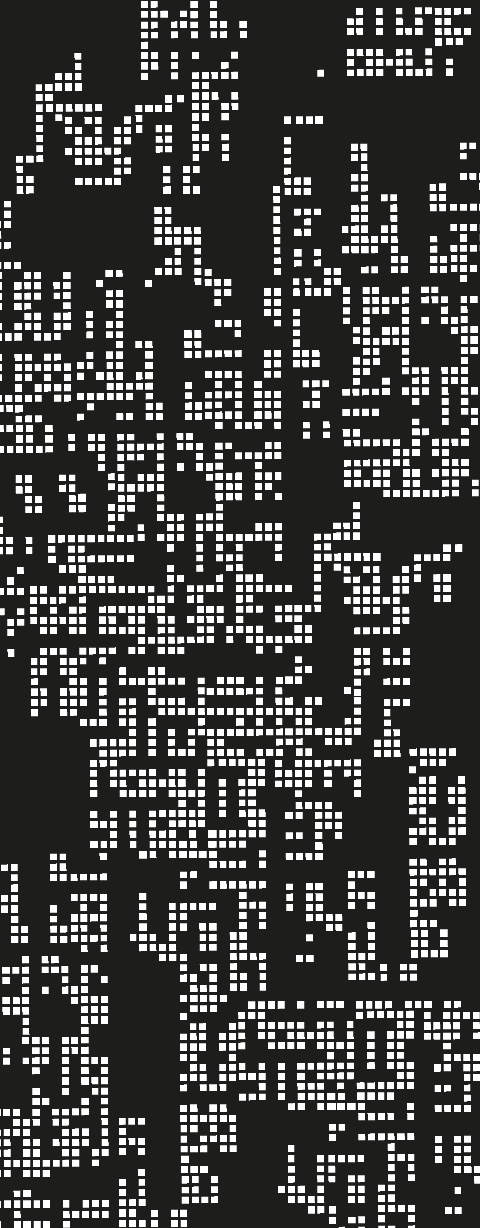
EEG2Audio 2024 UCSD Cognitive Science Summer Research Fellowship
Jacob Lamadrid

Slide 2
Project Outline
Audio Reconstruction | Seeking to extract/reconstruct auditory stimuli via deep learning models with some input neural signal, possible via time-frequency domain “images” (Spectrograms)
EEG2Image Models [1] | Inspired by existing work in image reconstruction from EEG/MRI, including current work performed at the lab
fMRI Audio Reconstruction | Majority of existing work in audio reconstruction is in the context of fMRI which is partially relevant to EEG but not entirely replicable
Benefits of EEG in Context | EEG provides an easy, non-invasive method for capturing neural signals over fMRI as well as a finer temporal resolution in recording
Challenges | Code from previous works in EEG to audio modeling is not publicly available and datasets for this task are extremely limited

Slide 3
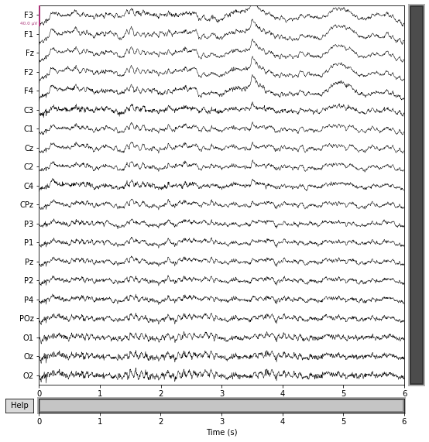
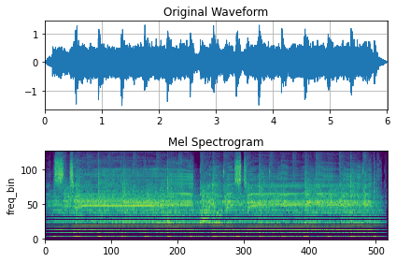
Data
Naturalistic Music EEG Dataset - Tempo (NMED-T) [6]
125 channel recording
Full length songs
MAD-EEG: an EEG dataset for decoding auditory attention to a target instrument in polyphonic music [7]
20 channel recording
Repeating music segments
Note:
Current publicly available datasets for EEG audio reconstruction restricted to music stimuli
Audio processed into MelSpectrograms*
Aggregated & Filtered EEG Data
Example MelSpectrogram
* ”An object of type MelSpectrogram represents an acoustic time-frequency representation of a sound: the power spectral density P(f, t). It is sampled into a number of points around equally spaced times and frequencies (on a Mel frequency scale)” [5]

Slide 4
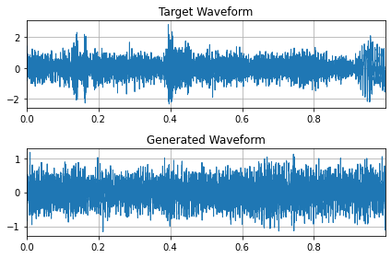
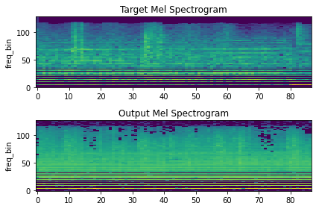
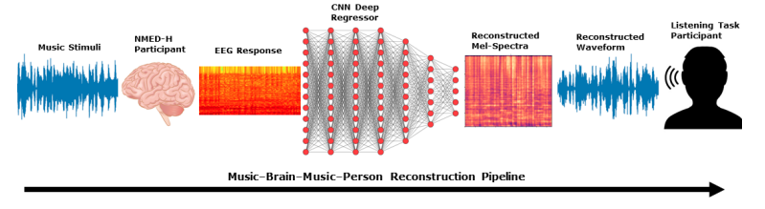
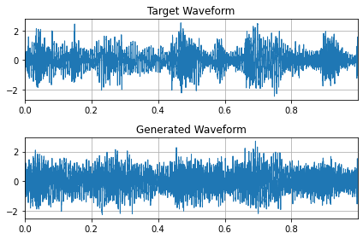
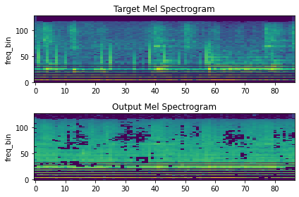
Overview of Methods
CNN (EEG2Mel) [2]
Convolutional Neural Network directly mapping EEG to audio
Input: Power Spectral Density array of EEG recording
Output: MelSpectrogram*
Findings
+ Least computationally intense
+ Easy model/procedure interpretability
- Poor with high variance
- Poor in fine temporal properties

Slide 5
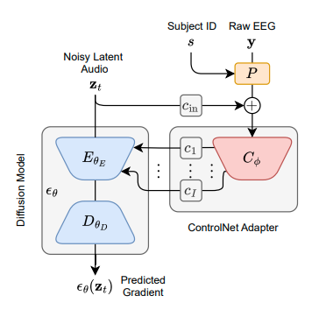
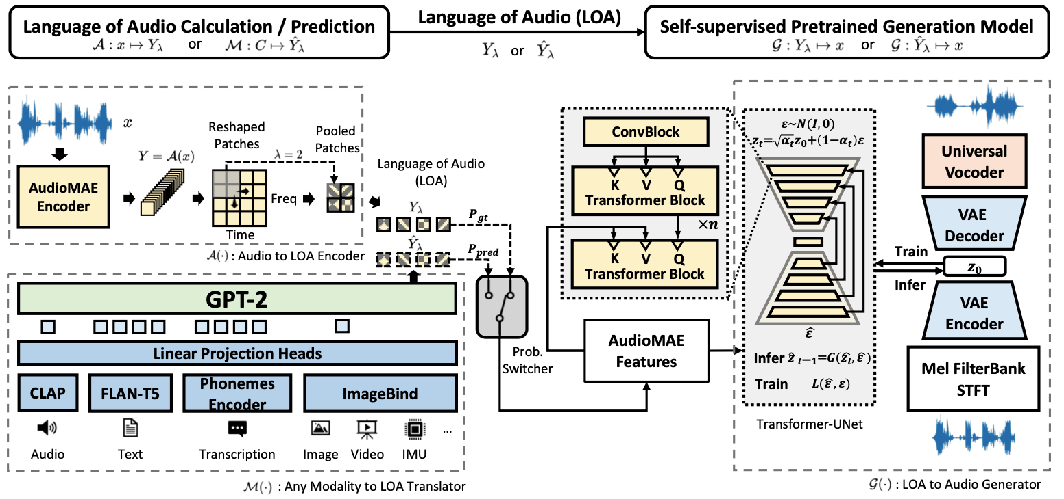
Overview of Methods
Diffusion (AudioLDM) [3]
Latent Diffusion Model utilizing a prompt generative model for conditioning outputs based on EEG
Input: Latent noise image + Projected EEG (Conditioning)
Output: Latent MelSpectrogram* (Ready for VAE decoding)
Findings
+ Pretrained model
+ Standard EEG to image method
- No publicly available implementations
- Data dimensionality issues

Slide 6
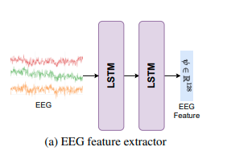
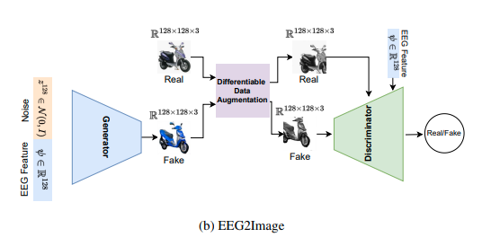
Overview of Methods
DCGAN (Future Work) [4]
Generative Adversarial Network generating audio based on EEG features then classifying real/fake audio
Input: EEG Features + Noise vector
Output: MelSpectrogram*
Findings
+ Fast inference
+ Enhanced feature extraction
+ Applications outside of music
+ Improved interpretability
- No existing work in audio

Slide 7
Outcomes & Future Work
Data and Model Preparation
Comprehensive EEG Audio Training Data
Working GAN Implementation
CNN model successfully set up for training on new data and 2 other models drafted
Current datasets are primarily utilizing fMRI or are limited to applications in music response
DCGAN model with a more comprehensive input
Thank you!
Special thanks to Simon, Ian, and Prof. de Sa

Slide 8
References
[1] Yunpeng Bai, Xintao Wang, Yan-pei Cao, Yixiao Ge, Chun Yuan, Ying Shan: “DreamDiffusion: Generating High-Quality Images from Brain EEG Signals”, 2023; arXiv:2306.16934.
[2] Adolfo G. Ramirez-Aristizabal, Chris Kello: “EEG2Mel: Reconstructing Sound from Brain Responses to Music”, 2022; arXiv:2207.13845.
[3] Emilian Postolache, Natalia Polouliakh, Hiroaki Kitano, Akima Connelly, Emanuele Rodolà, Luca Cosmo, Taketo Akama: “Naturalistic Music Decoding from EEG Data via Latent Diffusion Models”, 2024; arXiv:2405.09062.
[4] Prajwal Singh, Pankaj Pandey, Krishna Miyapuram, Shanmuganathan Raman: “EEG2IMAGE: Image Reconstruction from EEG Brain Signals”, 2023; arXiv:2302.10121.
[5] Jansson, A., Humphrey, E., Montecchio, N., Bittner, R. M., Kumar, A., & Weyde, T. (2018). Wave-U-Net: A Multi-Scale Neural Network for End-to-End Audio Source Separation. arXiv preprint arXiv:1806.03185.
[6] Steven Losorelli, Duc T. Nguyen, Jacek P. Dmochowski, and Blair Kaneshiro (to appear). NMED-T: A Tempo-Focused Dataset of Cortical and Behavioral Responses to Naturalistic Music. In Proceedings of the 18th International Society for Music Information Retrieval Conference, Suzhou, China.
[7] Giorgia Cantisani, Gabriel Trégoat, Slim Essid, Gael Richard. MAD-EEG: an EEG dataset for decoding auditory attention to a target instrument in polyphonic music. Speech, Music and Mind (SMM), Satellite Workshop of Interspeech 2019, Sep 2019, Vienna, Austria. ⟨hal-02291882v1⟩

